Slide 1
INTRODUCTION TO
SPORTS LAW
(SWITZERLAND)
4 WEEK ONLINE CERTIFICATE COURSE
COURSE FEE – CHF 790
START DATE: NOVEMBER 21, 2023
REGISTER NOW: info@alss-edu.ch

Slide 2
Course Introduction
The course Introduction to Sports Law & Governance is a four-week open course (every Tuesday two hours online), offered by the Academy of Leadership Sciences Switzerland, Zurich.
The course is designed and delivered by recognized experts in Sports Law. It is being offered as an open course and can be attended by anyone who is, or aspires to get, involved in the industry of sports - including sports administrators, lawyers, sports agents, or intermediaries, current and former athletes, among others.
Course content
The course covers specific topics on sport-related issues including an introduction into sports law, sport governing bodies, sports governance, anti-doping, dispute resolution, Court of Arbitration for Sports (CAS) and other topics.
Accreditation and certification
The Academy of Leadership Sciences Switzerland (ALSS) is an international education institution that offers continuing education, further education, and post graduate advanced education courses, workshops and programs focusing on advanced studies in Leadership and Management. The ALSS also offers short courses that are not credit- bearing, and do not lead to formal qualifications. All attendees who attend all the four presentations for the Introduction to Sports Law course will be awarded certificates of successful attendance by the ALSS.
Course Structure
Week
Introduction to Sports Law (2 hours)
What is Sports Law?
Globalization of Sport
Autonomy of sport
Regulatory Framework
National and International regulation of sport and Sports Law
1
WORLD TRADE CENTER,
LEUTSCHENBACHSTRASSE 95 CH-8050 ZÜRICH, SWITZERLAND

Slide 3
Week
Integrity, Match Fixing and Good Governance (2 hours)
An Overview of Sports Governance
Olympic Charter
Sports Law and Integrity
Match Fixing
2
Anti-doping and Dispute Resolution System Inside the Structures of FIFA (2 hours)
Regulatory framework, WADA
Anti-doping Rule Violations
Sanctions
Disciplinary process – an overview
The FIFA Football Tribunal – deciding bodies
FIFA competence
Competence of the various chambers
Appeals
Week
3
Week
Dispute Resolution in Sport (2 hours)
The Court of Arbitration for Sport
Disciplinary matters
Disputes & differences
4
Duration of the Course:
4 weeks (every Tuesday two hours webinar at 18h00 CET)
Language
English
Start Date
21 November 2023
Study Options
100 % online per Zoom
Admission Requirements Anyone who is, or aspires to get, involved in the industry of sports can enrol for this course.
Tutorial fees for the whole course
CHF 790 to be paid at least one week before the course starts.
Internet access and an email address are required.
+41 (0)44 308 35 22
INFO@ALSS-EDU.CH | WWW.ALSS-EDU

Slide 4
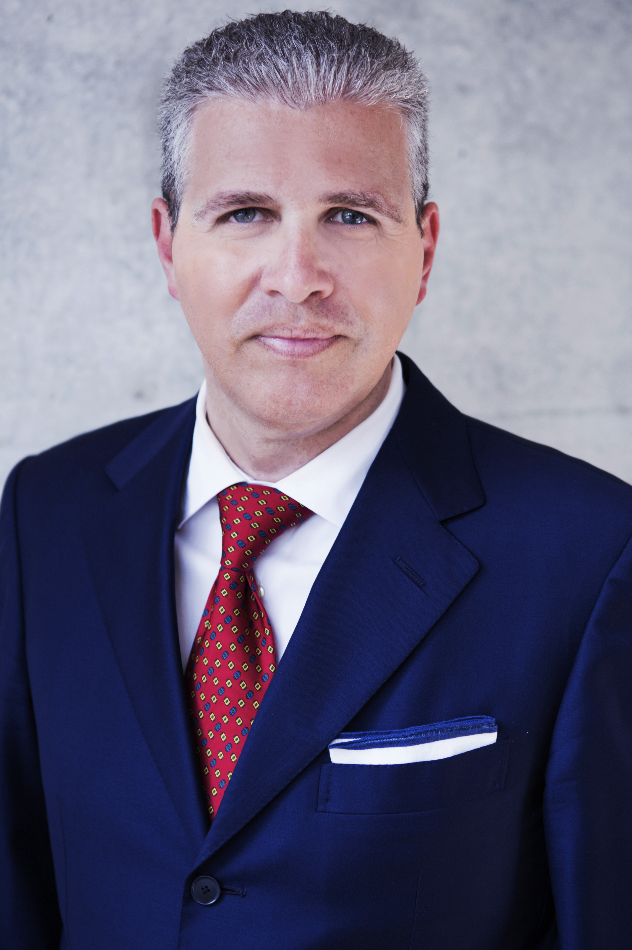
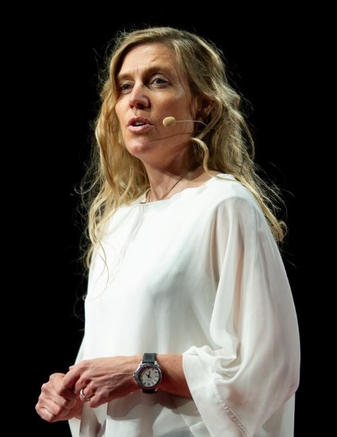
Course Presenters
Gianpaolo Monteneri is an expert in the field of international sports and football law. He specialises in sport-related litigation, with a particular emphasis on the resolution of disputes relating to football. He also advises extensively in relation to contractual matters in transfers, employment, agency and sponsorship matters.
After graduating as a Swiss lawyer, Gianpaolo joined FIFA in 1997 as Head of the Players' Status Department. For more than 8 years, Gianpaolo headed a team of international lawyers at FIFA in charge of investigating commercial and labour disputes.
Gianpaolo has represented clients in more than 200 procedures before the Court of Arbitration for Sport (TAS/CAS), a large number of procedures before the FIFA and UEFA deciding bodies and ad-hoc arbitration procedures.
Gianpaolo Monteneri
Course Presenter
Besides her activities as entrepreneur
and leader of charity projects, Andrea
Sherpa-Zimmermann is a specialist
Sports Law Attorney working since
more than a decade at the Court of
Arbitration for Sport, in Lausanne,
Switzerland. She has thus an extensive
Experience in sports dispute
resolution at international level.
Education:
MLaw (University of Lousane)
Andrea Sherpa-Zimmermann
Course Presenter

Slide 5
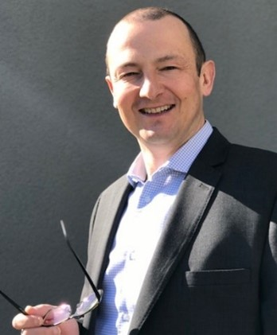
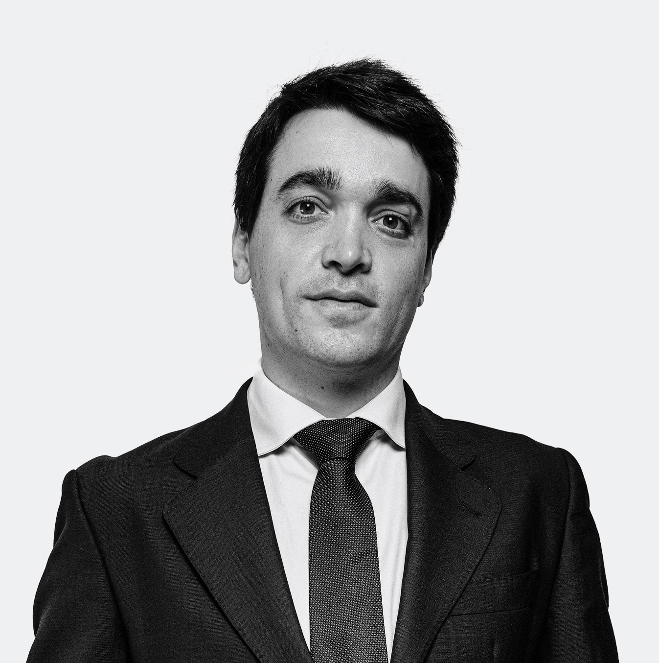
Course Presenters
Omar Ongaro is an expert technical advisor in Football Regulatory matters, Of Counsel with Morgan Sports Law (a boutique law firm devoted to sports arbitration and litigations) and a CAS arbitrator.
A graduate of the University of Zurich, Switzerland (lic.iur. 1997), he has been acting in various positions for the world football governing body FIFA as of March 2000 for almost 2 decades. First appointed responsible person for all players’ agents’ matters within the Players’ Status Department, he was then actively involved in the proceedings leading to FIFA’s recognition of the jurisdiction of the Court of Arbitration for Sport (CAS) and was subsequently in charge within the Players’ Status Department of supervising and coordinating appeal procedures at the CAS involving FIFA.
Omar Ongaro Course Presenter
Jaime has worked in the sports industry for almost a decade.
Between 2014 and 2018, Jaime worked at FIFA’s Disciplinary department of which he became the Head in 2017. In December 2018, Jaime was appointed Head of FIFA’s Litigation department, a newly created team entrusted with the defence of all decisions passed by the different deciding bodies of FIFA that are challenged before the Court of Arbitration for Sport and the Swiss Federal Tribunal. He held this position until the end of 2021. During this period, Jaime participated in -and oversaw- hundreds of arbitral procedures on a wide variety of topics.
Education:
Law Degree from the Universidad PontificiaComillas (ICADE) in Madrid, Spain
LL.M. from IE in Madrid, Spain
Jaime Cambreleng
Course Presenter

Slide 6
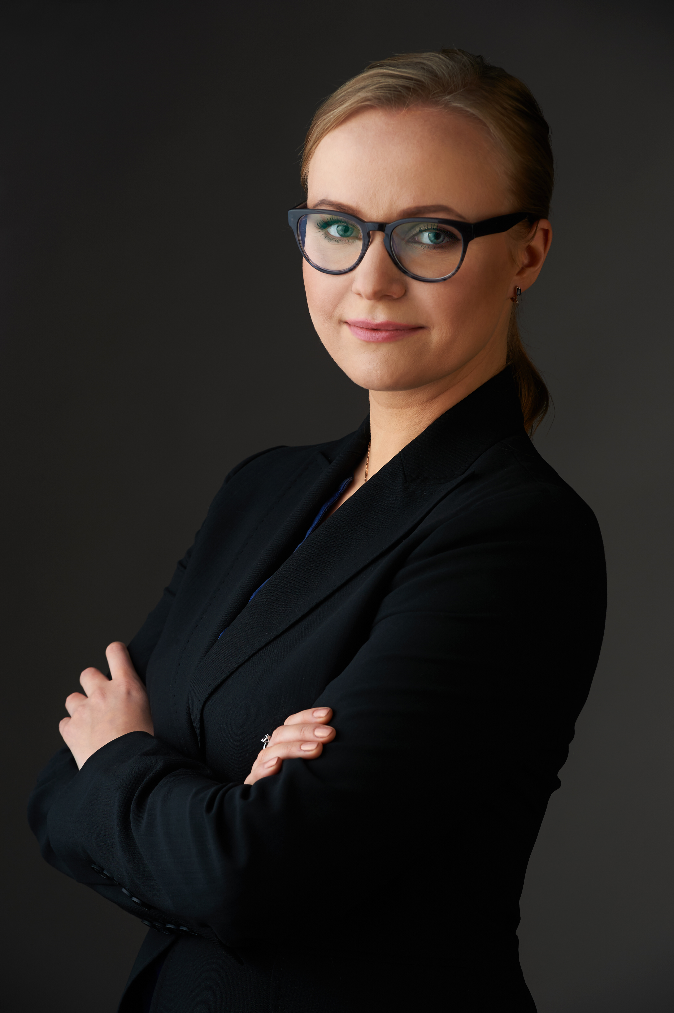
Course Presenters
Anna is working as an attorney in the field of international sports law. She is particularly focused on the dispute resolution before the Court of Arbitration for Sport (TAS/CAS), the FIFA Football Tribunal as well as before the FIFA and UEFA disciplinary bodies. Since the beginning of her career back in 2009, Anna has been involved in over 100 cases resolved in front of the Court of Arbitration for Sport. She is regularly engaged in the football transfers, providing legal advice on the contractual, employment-related, image rights, agency and other issues. Since 2017 Anna is also a member of the World Athletics Disciplinary Tribunal, and since 2021 she is a member of the International Table Tennis Tribunal.
Anna Smirnova
Course Presenter

